Slide 1

CS4225/CS5425 Big Data Systems for Data Science
Steaming Processing
Ai Xin
School of Computing
National University of Singapore
aixin@comp.nus.edu.sg

Slide 2
Today’s Plan
Introduction
Spark
Flink

Slide 3
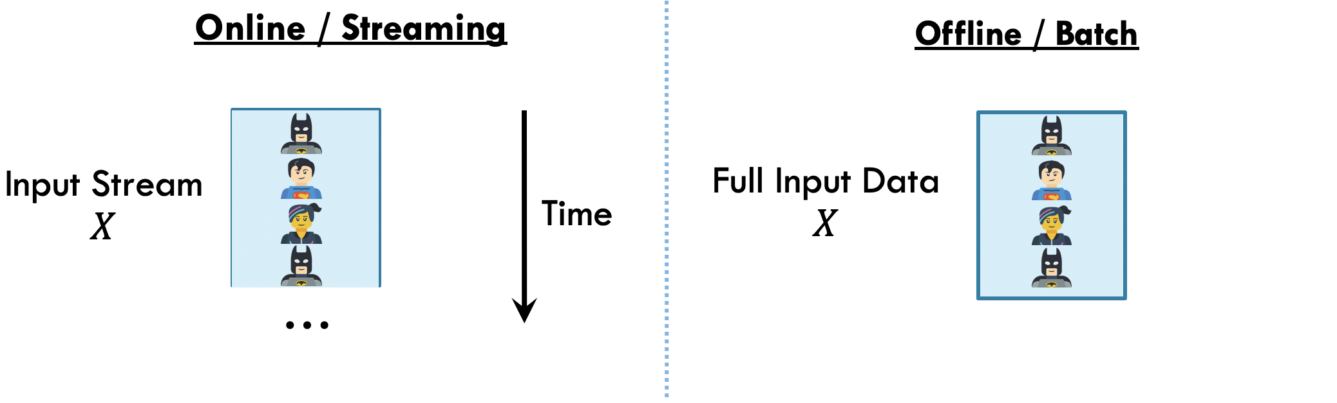
Streams: Motivation
In many settings, the data is arriving over time; it is not received all at once
Streaming (or “online”) approaches are designed to process their input as it is received
This is in contrast to offline or batch approaches that operate on the full dataset, all at once

Slide 4
Streaming Data
Input elements enter at a rapid rate from input ports (e.g. receiving data from a sensor, from a TCP connection, from a file stream, or from a message queue)
Elements of the stream are sometimes referred to as ‘tuples’
The stream is potentially infinite; the system cannot store the entire stream accessibly (due to limited memory)

Slide 5
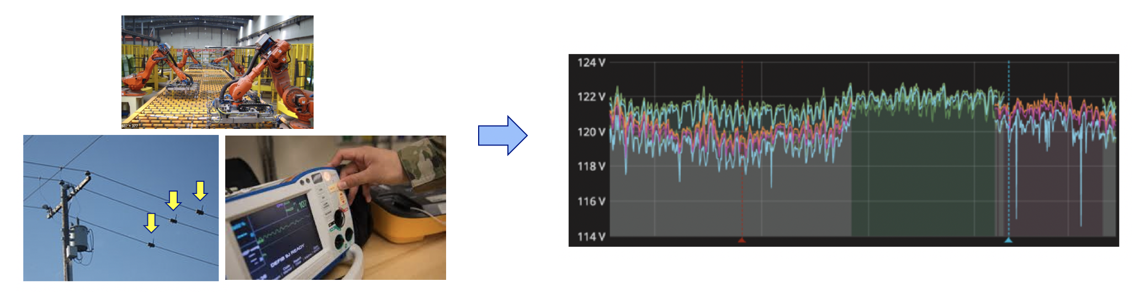
Example Applications
In many real settings, data is high volume and constantly arriving over time
Sensor data (industrial, environmental, medical, etc)

Slide 6




Example Applications
In many real settings, data is high volume and constantly arriving over time
Online user activity data

Slide 7


Example Applications
In many real settings, data is high volume and constantly arriving over time
Financial Transactions (e.g. credit card fraud detection)
Stock Trades Data (e.g. trades, orders, prices)
https://www.kaggle.com/borismarjanovic/price-volume-data-for-all-us-stocks-etfs

Slide 8
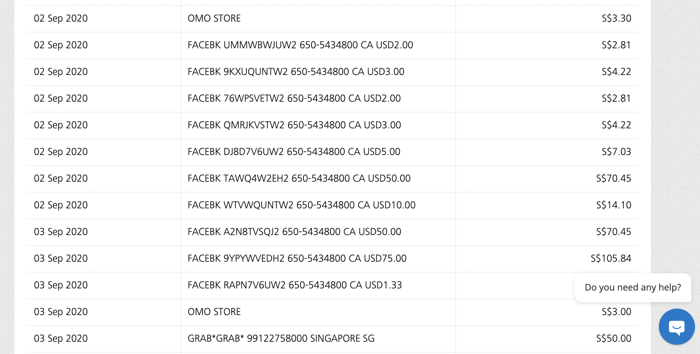

Slide 9
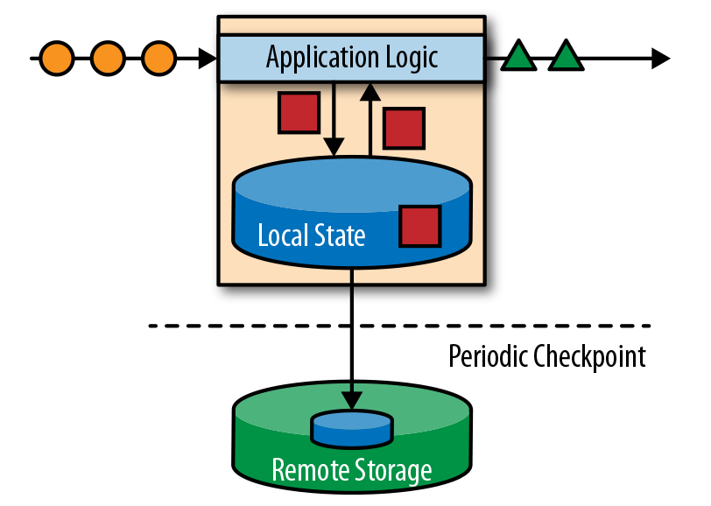
Stateful Stream Processing
not just perform trivial record-at-a-time transformations
the ability to store and access intermediate data
state can be stored and accessed in many different places including program variables, local files, or embedded or external databases

Slide 10
Today’s Plan
Introduction
Spark
Flink

Slide 11
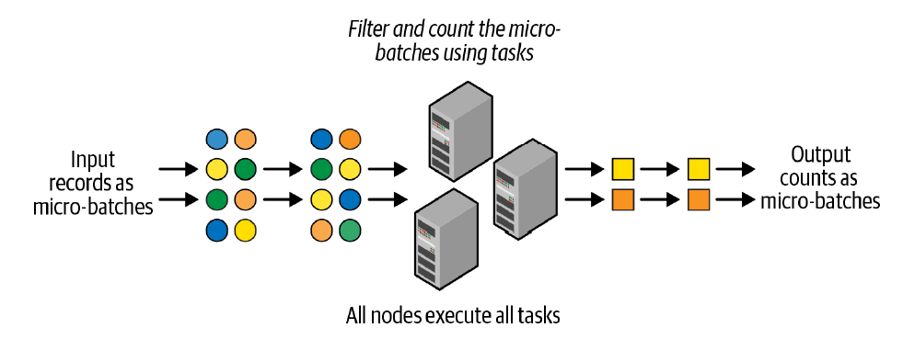
Micro-Batch Stream Processing
Structured Streaming uses a micro-batch processing model
divides the data from the input stream into micro batches
each batch is processed in the Spark cluster in a distributed manner
small deterministic tasks generate the output in micro-batches
Advantages
quickly and efficiently recover from failures
deterministic nature ensures end-to-end exactly-once processing guarantees
Disadvantages: latencies of a few seconds
This is actually OK for many applications
Application may incur more than a few
seconds delay in other parts of pipeline

Slide 12
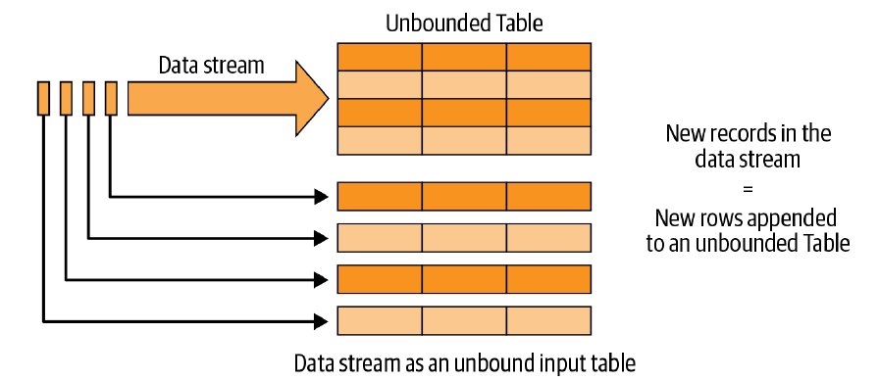
The Philosophy of Structured Streaming
For developers, writing stream processing pipelines should be as easy as writing batch pipelines.
A single, unified programming model and interface for batch and stream processing
A broader definition of stream processing
The Structured Streaming programming model: data stream as an unbounded table
Notes:
Thinking of the data streams as tables not only makes it easier to conceptualize the
logical computations on the data, but also makes it easier to express them in code.
Since Spark’s DataFrame is a programmatic representation of a table, you can use the
DataFrame API to express your computations on streaming data. All you need to do
is define an input DataFrame (i.e., the input table) from a streaming data source, and
then you apply operations on the DataFrame in the same way as you would on a
DataFrame defined on a batch source.

Slide 13
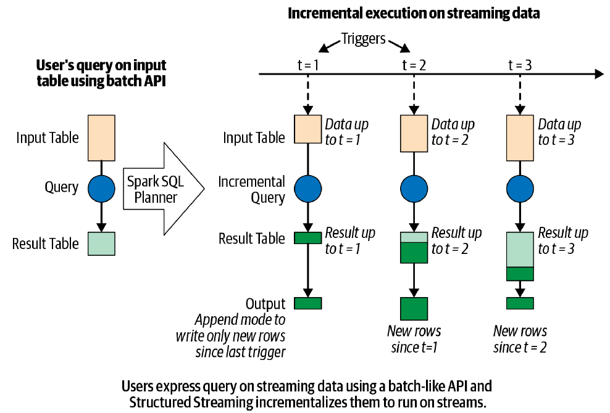
The Structured Streaming processing model

Slide 14
Five Steps to Define a Streaming Query
Step 1: Define input sources
Step 2: Transform data
Step 3: Define output sink and output mode
Output writing details (where and how to write the output)
Processing details (how to process data and how to recover from failures)
Step 4: Specify processing details
Triggering details: when to trigger the discovery and processing of newly available streaming data.
Checkpoint Location: store the streaming query process info for failure recovery
Step 5: Start the query

Slide 15
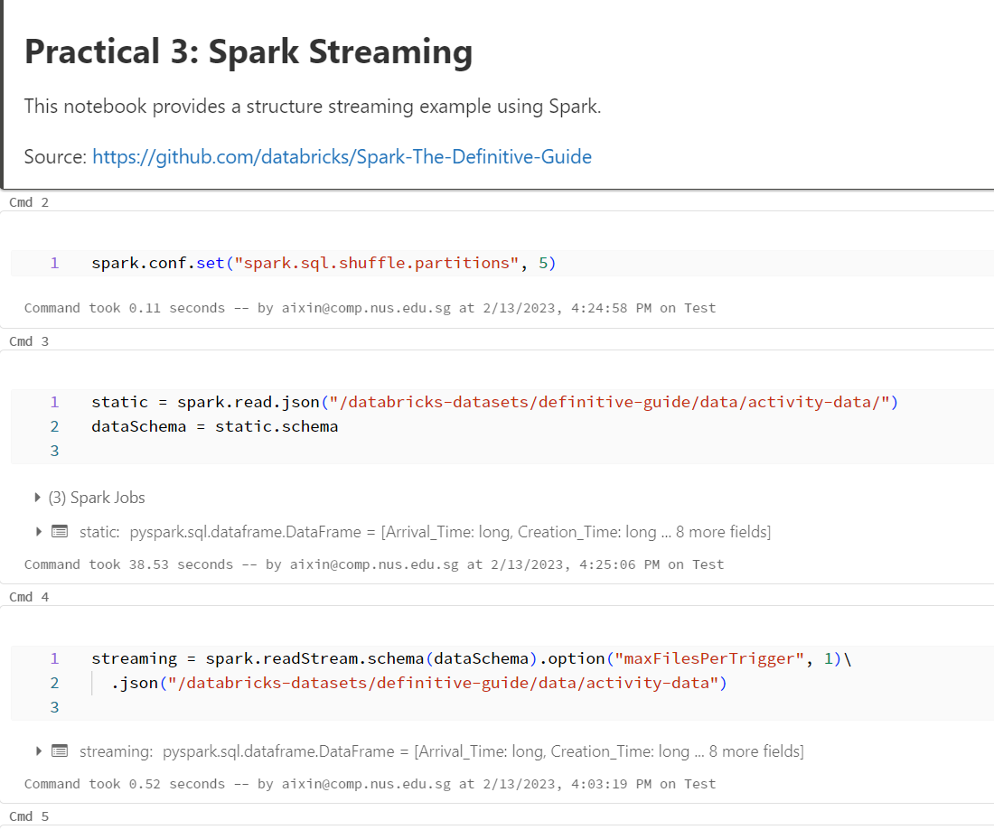
Practical 3: Spark Streaming

Slide 16
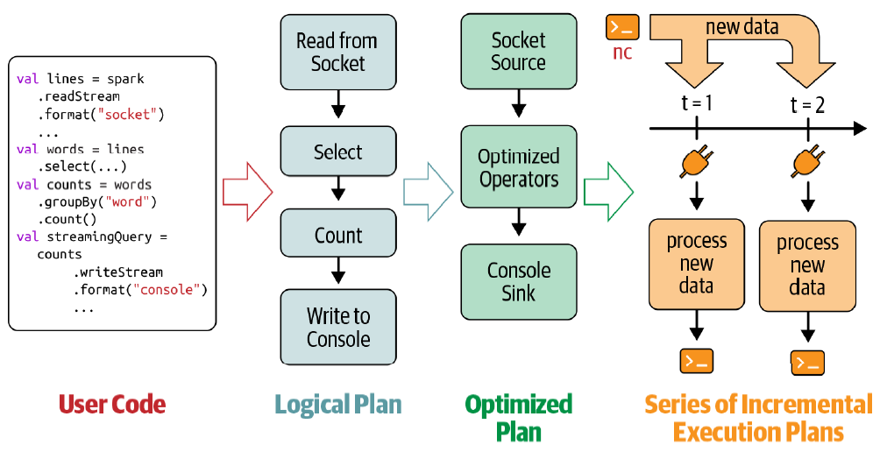
Incremental execution of streaming queries

Slide 17
Data Transformation
Stateless Transformation
Process each row individually without needing any information from previous rows
Projection operations: select(), explode(), map(), flatMap()
Selection operations: filter(), where()
Stateful Transformation
A simple example: DataFrame.groupBy().count()
In every micro-batch, the incremental plan adds the count of new records to the previous count generated by the previous micro-batch
The partial count communicated between plans is the state
The state is maintained in the memory of the Spark executors and is checkpointed to the configured location to tolerate failures.

Slide 18
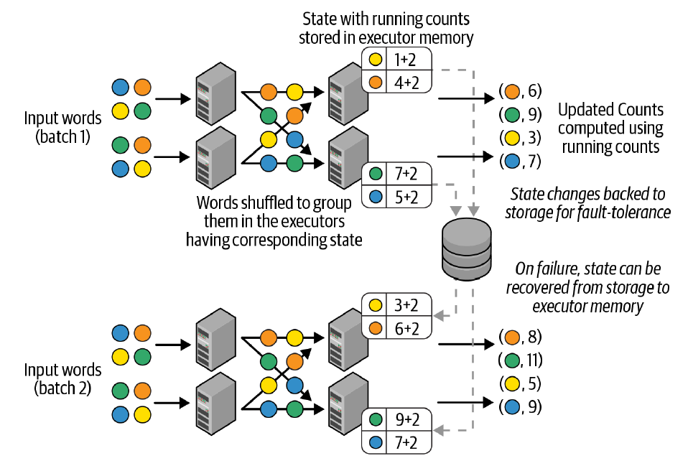
Distributed state management in Structured Streaming
Notes:
Each micro-batch reads a new set of words, shuffles them within the executors to
group them, computes the counts within the micro-batch, and finally adds them to
the running counts to produce the new counts. These new counts are both the output
and the state for the next micro-batch, and hence they are cached in the memory of
the executors.
However, it is not sufficient to just keep this state in memory, as any failure (either of
an executor or of the entire application) will cause the in-memory state to be lost. To
avoid loss, we synchronously save the key/value state update as change logs in the
checkpoint location provided by the user.

Slide 19
Stateful Streaming Aggregations
Aggregations Not Based on Time
Global aggregations
Grouped aggregations
All built-in aggregation functions in DataFrames are supported
sum(), mean(), stddev(), countDistinct(), collect_set(), approx_count_distinct(), and etc.
Notes:
You cannot use direct aggregation operations like Data
Frame.count() and Dataset.reduce() on streaming Data‐
Frames. This is because, for static DataFrames, these
operations immediately return the final computed aggregates,
whereas for streaming DataFrames the aggregates have to be
continuously updated. Therefore, you have to always use Data
Frame.groupBy() or Dataset.groupByKey() for aggregations
on streaming DataFrames.

Slide 20
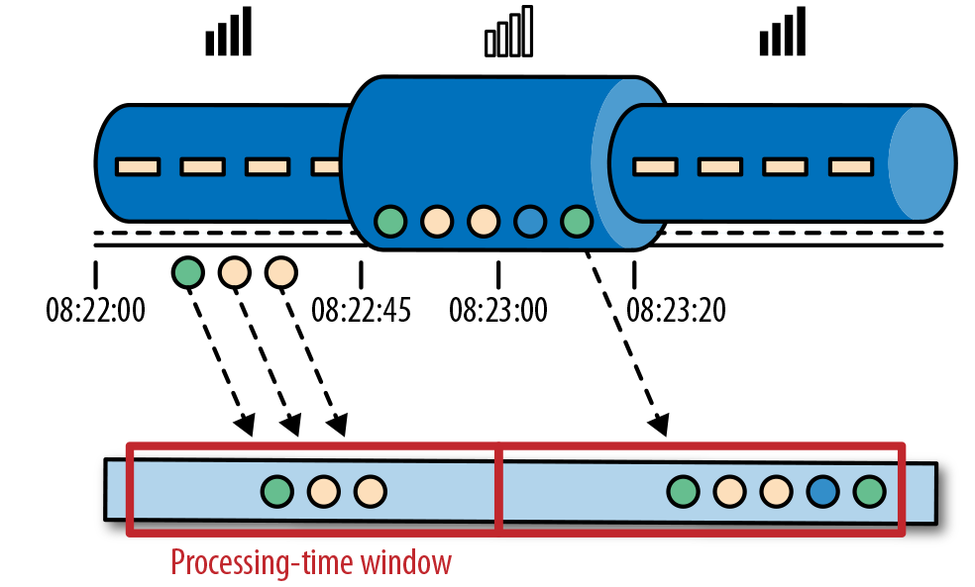
Time Semantics
Processing Time: the time of stream processing machine
Notes:
Consider a program that analyzes events generated by users playing an online mobile game. Users are organized in teams and the application collects a team’s activity and provides rewards in the game, such as extra lives and level-ups, based on how fast the team’s members meet the game’s goals. For example, if all users in a team pop 500 bubbles within one minute, they get a level-up. Alice is a devoted player who plays the game every morning during her commute to work. The problem is that Alice lives in Berlin and takes the subway to work. And everyone knows that the mobile internet connection in the Berlin subway is lousy. Consider the case where Alice starts popping bubbles while her phone is connected to the network and sends events to the analysis application. Then suddenly the train enters a tunnel and her phone gets disconnected. Alice keeps on playing and the game events are buffered in her phone. When the train exits the tunnel, she comes back online, and pending events are sent to the application. What should the application do? What’s the meaning of one minute in this case? Does it include the time Alice was offline or not?

Slide 21
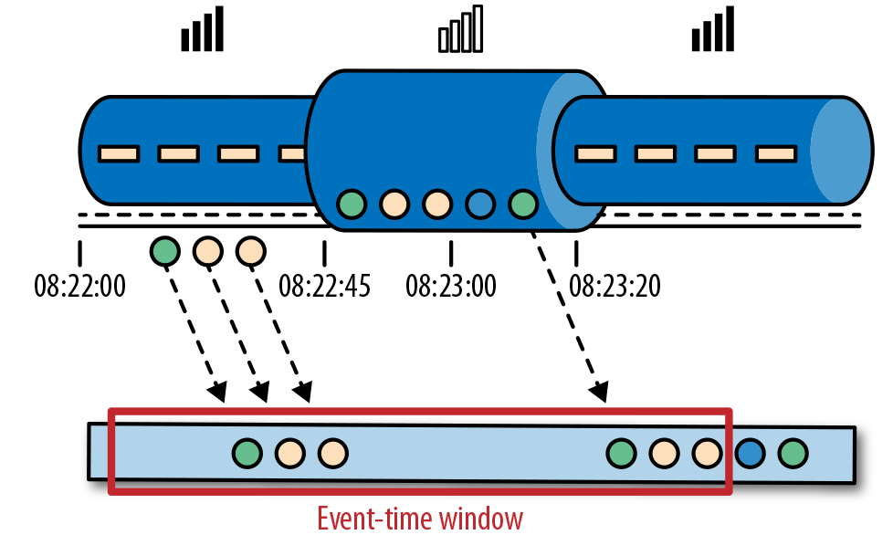
Time Semantics
Event Time: the time an event actually happened

Slide 22
Time Semantics
Event time completely decouples the processing speed from the results.
Operations based on event time are predictable and their results are deterministic.
An event time window computation will yield the same result no matter how fast the stream is processed or when the events arrive at the operator.
how long do we have to wait before we can be certain that we have received all events that happened before a certain point of time?
watermarks

Slide 23
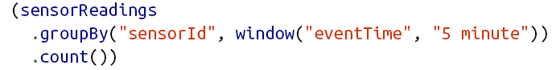
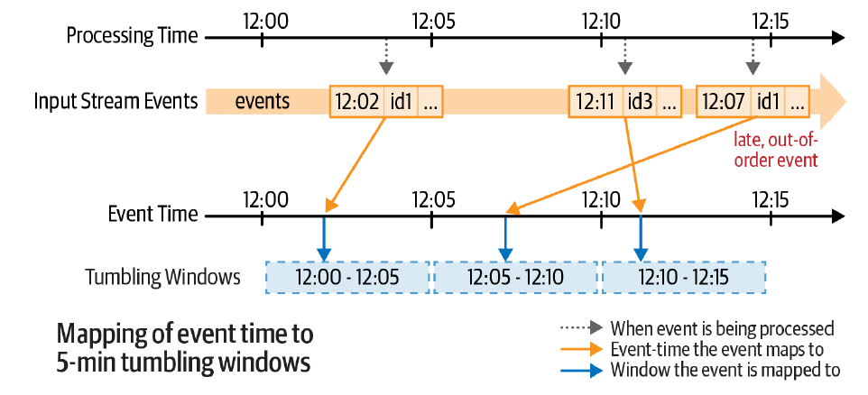
Stateful Streaming Aggregations
Aggregations with Event-Time Windows

Slide 24
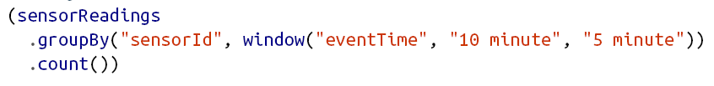
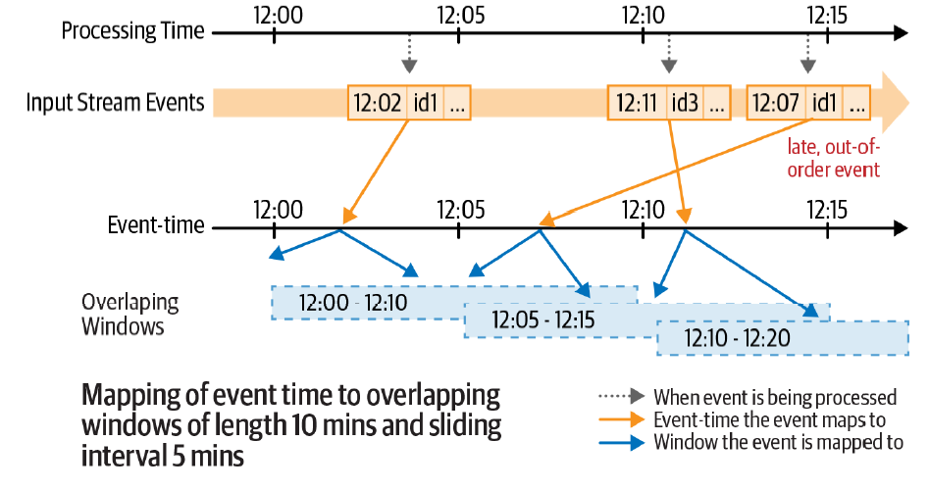

Slide 25
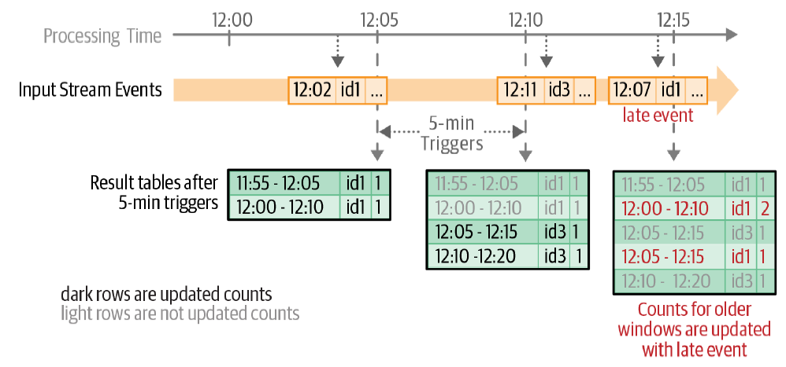
Updated counts in the result table after each five-minute trigger

Slide 26
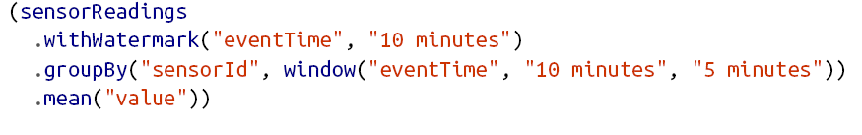
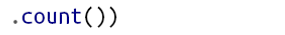
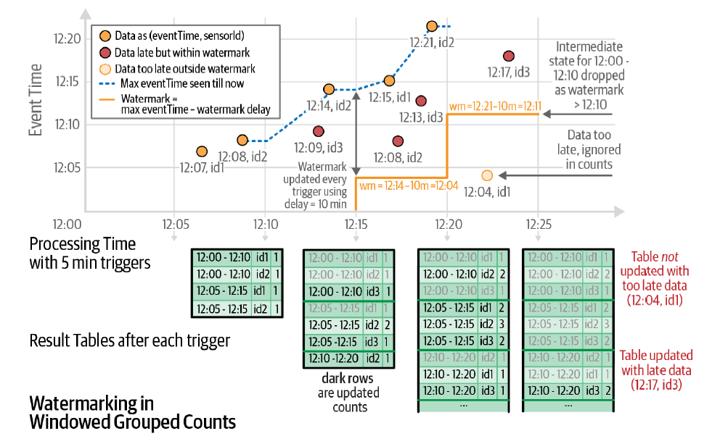
Handling Late Data with Watermarks
Notes:
A watermark of 10 minutes guarantees that the engine will never drop any data that is
delayed by less than 10 minutes compared to the latest event time seen in the input
data. However, the guarantee is strict only in one direction. Data delayed by more
than 10 minutes is not guaranteed to be dropped—that is, it may get aggregated.
Whether an input record more than 10 minutes late will actually be aggregated or not
depends on the exact timing of when the record was received and when the microbatch
processing it was triggered.

Slide 27
Performance Tuning
Besides tuning Spark SQL engine, a few other considerations
Cluster resource provisioning appropriately to run 24/7
Number of partitions for shuffles to be set much lower than batch queries
Setting source rate limits for stability
Multiple streaming queries in the same Spark application

Slide 28
Today’s Plan
Introduction
Spark
Flink

Slide 29
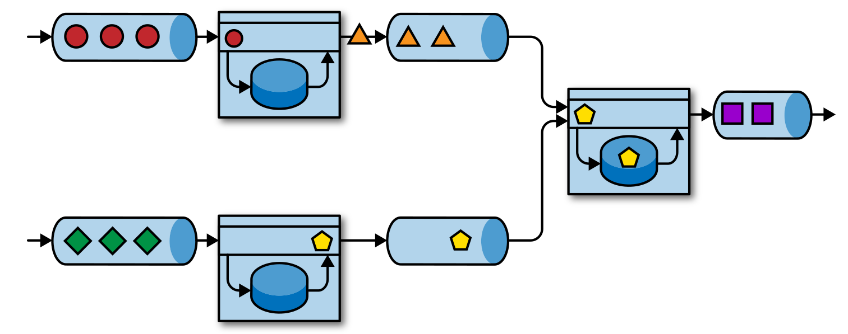
Event-driven streaming application
Notes:
The applications in the figure are connected by event logs. One application emits its output to an event log and another application consumes the events the other application emitted. The event log decouples senders and receivers and provides asynchronous, nonblocking event transfer. Each application can be stateful and can locally manage its own state without accessing external datastores. Applications can also be individually operated and scaled.

Slide 30
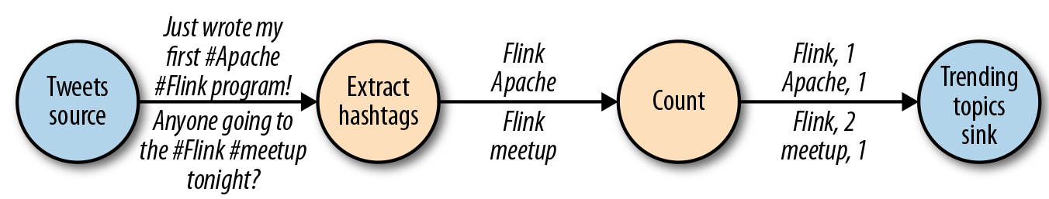
Dataflow Model
Dataflow Graph
A logical dataflow graph to continuously count hashtags (nodes represent operators and edges denote data dependencies)

Slide 31
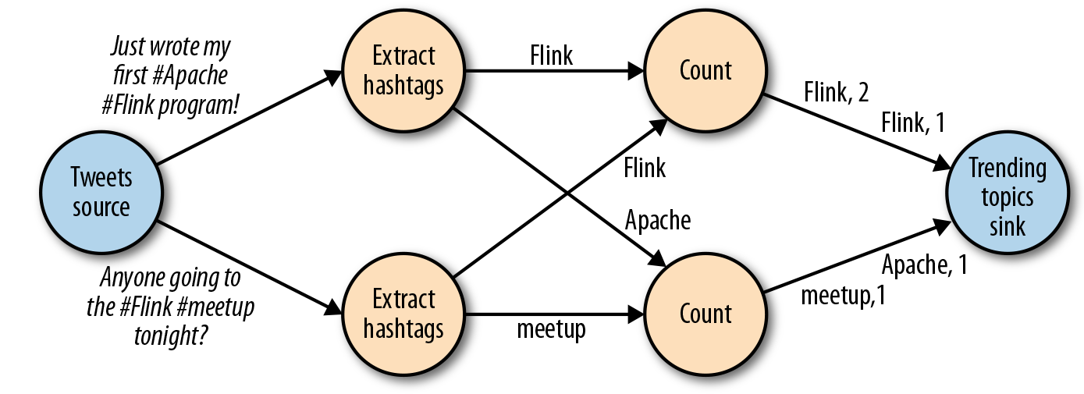
Dataflow Model
A physical dataflow plan for counting hashtags (nodes represent tasks)

Slide 32
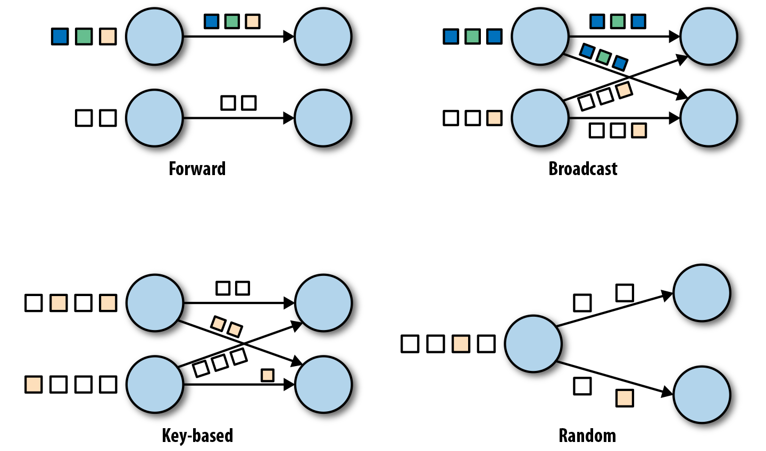
Dataflow Model
Data Exchange Strategies

Slide 33
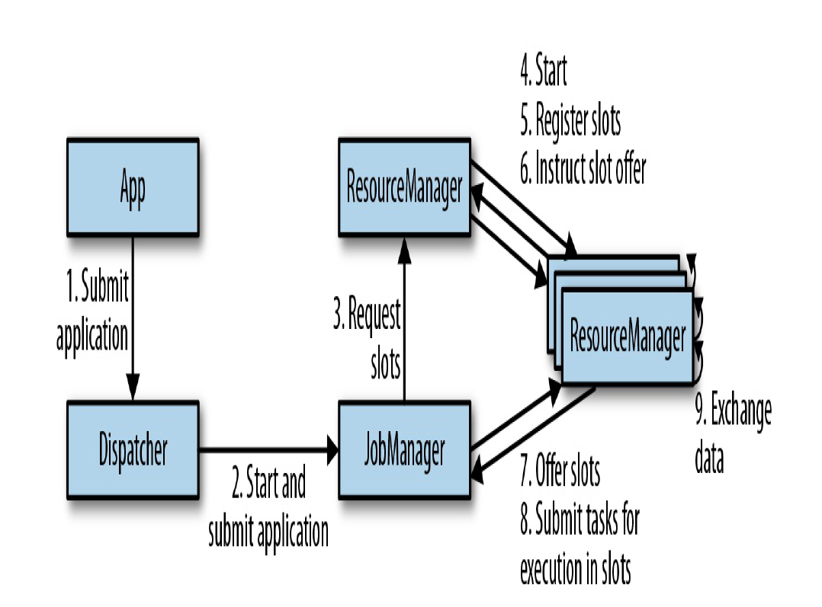
System Architecture
Flink is a distributed system for stateful parallel data stream processing.
Task Manager
Notes:
The Dispatcher runs across job executions and provides a REST interface to submit applications for execution. Once an application is submitted for execution, it starts a JobManager
and hands the application over.
The ResourceManager is responsible for managing TaskManager slots, Flink’s unit of processing resources.

Slide 34
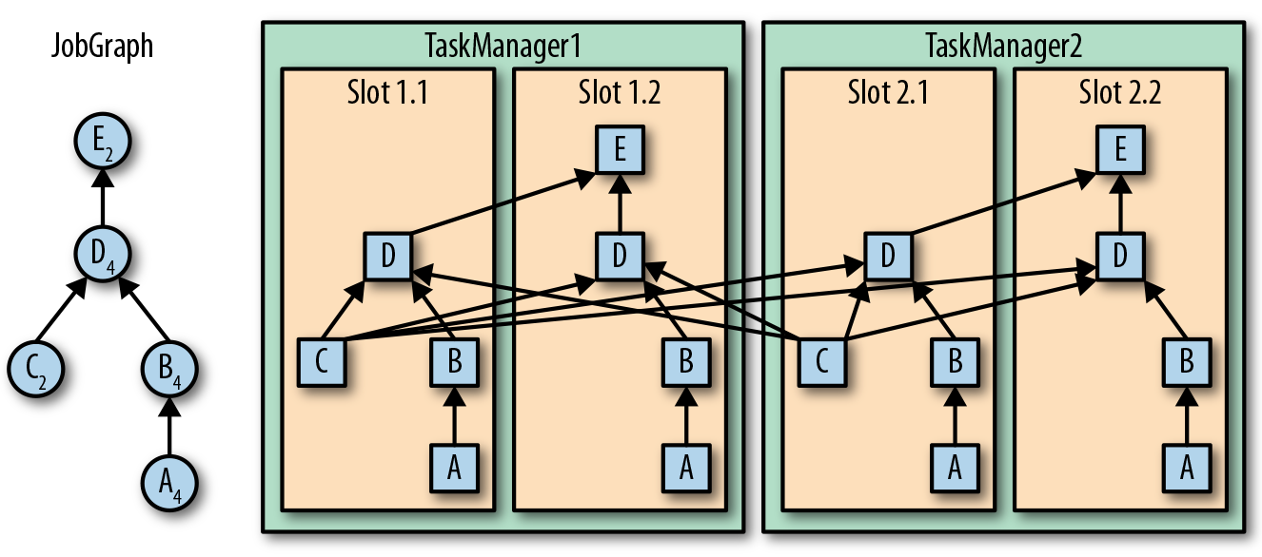
Task Execution
A TaskManager can execute several tasks at the same time:
tasks of the same operator (data parallelism)
tasks of different operators (task parallelism)
tasks from a different application (job parallelism)

Slide 35
Task Execution
A TaskManager
offers a certain number of processing slots to control the number of tasks it is able to concurrently execute.
A processing slot
can execute one slice of an application—one parallel task of each operator of the application.

Slide 36
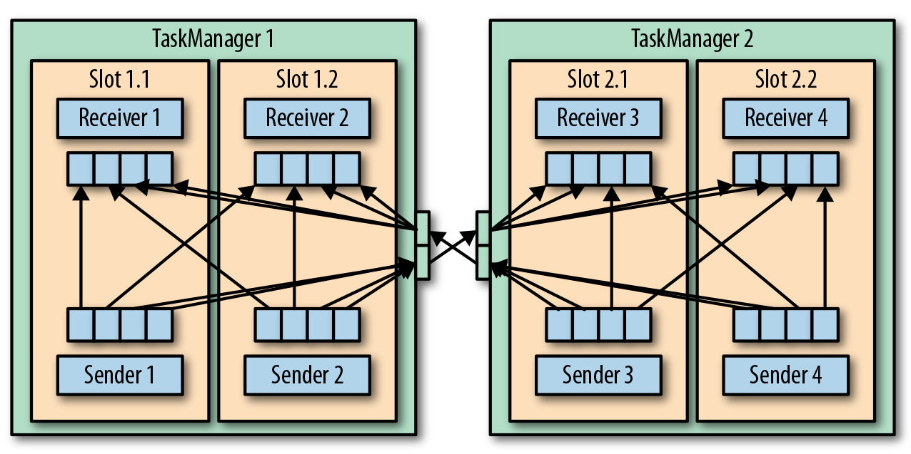
Data Transfer in Flink
The tasks of a running application are continuously exchanging data.
The TaskManagers take care of shipping data from sending tasks to receiving tasks.
The network component of a TaskManager collects records in buffers before they are shipped.

Slide 37
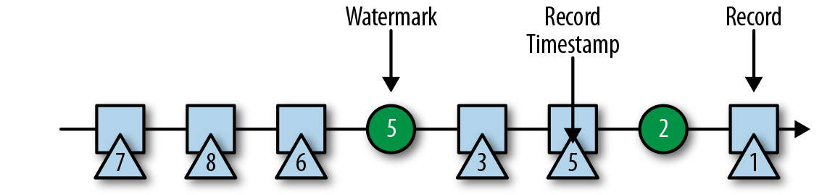
Even-Time Processing
In Flink, watermarks are implemented as special records holding a timestamp as a Long value.
In Flink, watermarks are implemented as special records holding a timestamp as a Long value.
Timestamps
Every record must be accompanied by an event timestamp
Watermarks
a Flink event-time application must also provide watermarks
Watermarks are used to derive the current event time at each task in an event-time application
In Flink, watermarks are implemented as special records holding a timestamp as a Long value. Watermarks flow in a stream of regular records with annotated timestamps.

Slide 38
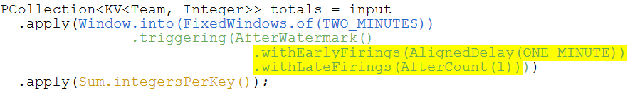
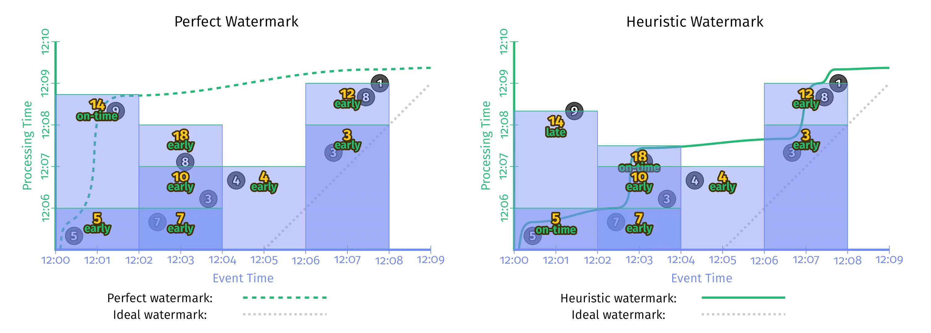
A Simple Counting Example
Optional

Slide 39
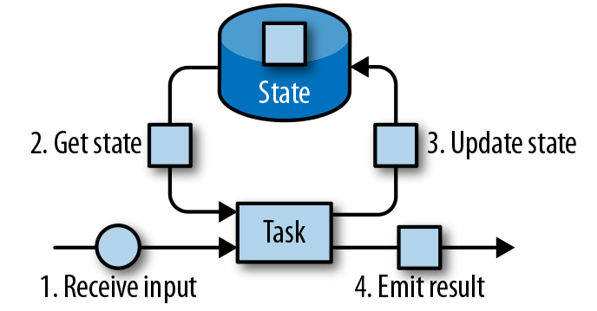
State Management
A stateful stream processing task
all data maintained by a task and used to compute the results of a function belong to the state of the task

Slide 40
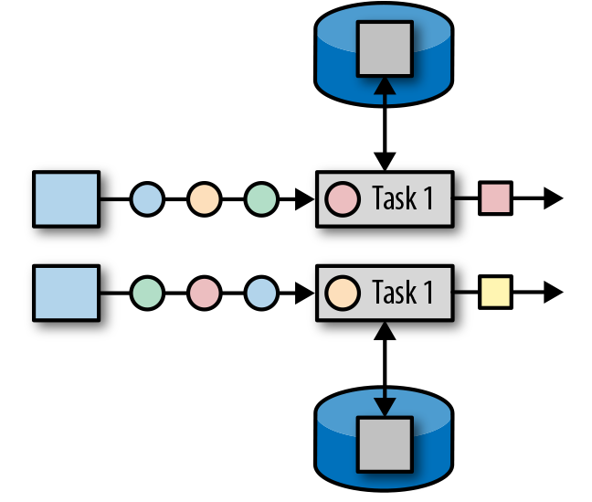
State Management
Operator State
Scoped to an operator task
All records processed by the same parallel task have access to the same state
Operator state cannot be accessed by another task of the same or a different operator

Slide 41
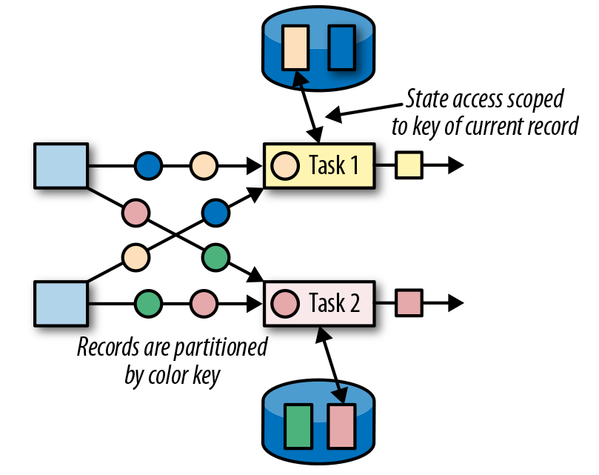
State Management
Keyed State
maintains one state instance per key value
partitions all records with the same key to the operator task that maintains the state for this key

Slide 42
State Management
State Backend
Local State Management
a task of a stateful operator typically reads and updates its state for each incoming record.
each parallel task locally maintains its state in memory to ensure fast state accesses
Checkpointing
A TaskManager process may fail at any point, hence its storage must be considered volatile
Checkpointing the state of a task to a remote and persistent storage
The remote storage for checkpointing could be a distributed filesystem or a database system

Slide 43
Checkpoints
Consistent checkpoints: similar to Spark micro-batch checkpoints
Pause the ingestion of all input streams
Wait for all in-flight data to be completely processed, meaning all tasks have processed all their input data.
Take a checkpoint by copying the state of each task to a remote, persistent storage. The checkpoint is complete when all tasks have finished their copies.
Resume the ingestion of all streams.
Stop-the-world

Slide 44
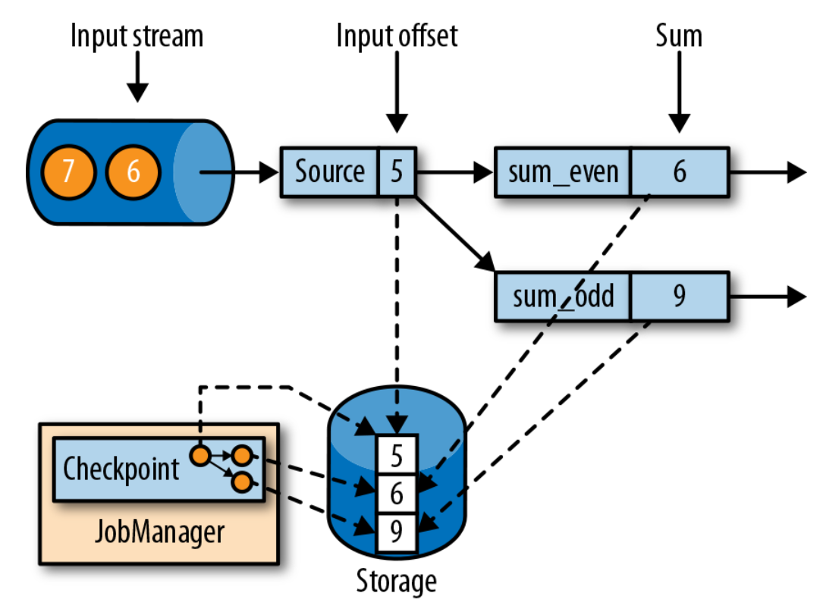
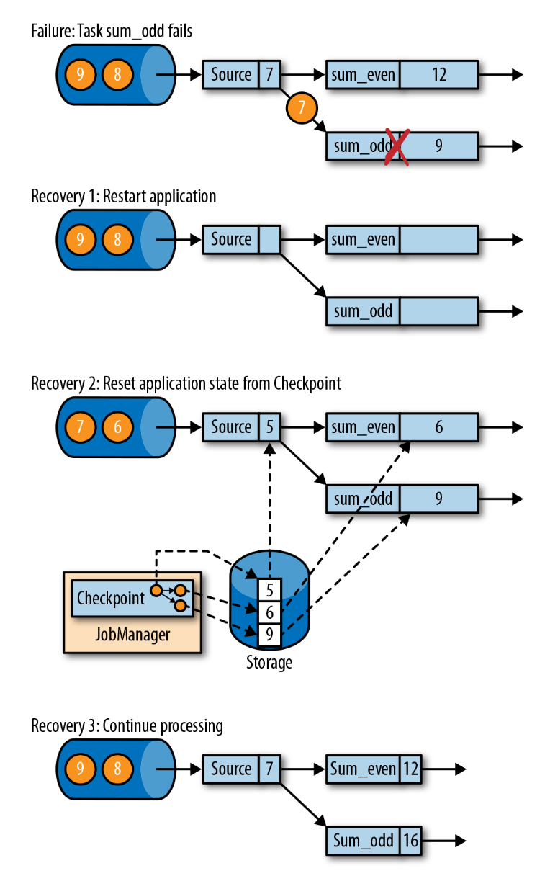
A consistent checkpoint
Failure Recovery from a consistent checkpoint
Restart the whole application.
Reset the states of all stateful tasks to the latest checkpoint.
Resume the processing of all tasks.

Slide 45
Checkpoints
Flink’s Checkpointing Algorithm
based on the Chandy–Lamport algorithm for distributed snapshots
does not pause the complete application but decouples checkpointing from processing
some tasks continue processing while others persist their state
More details
uses a special type of record called a checkpoint barrier
checkpoint barriers are injected by source operators into the regular stream of records and cannot overtake or be passed by other records
A checkpoint barrier carries a checkpoint ID to identify the checkpoint it belongs to and logically splits a stream into two parts
All state modifications due to records that precede a barrier are included in the barrier’s checkpoint and all modifications due to records that follow the barrier are included in a later checkpoint.

Slide 46
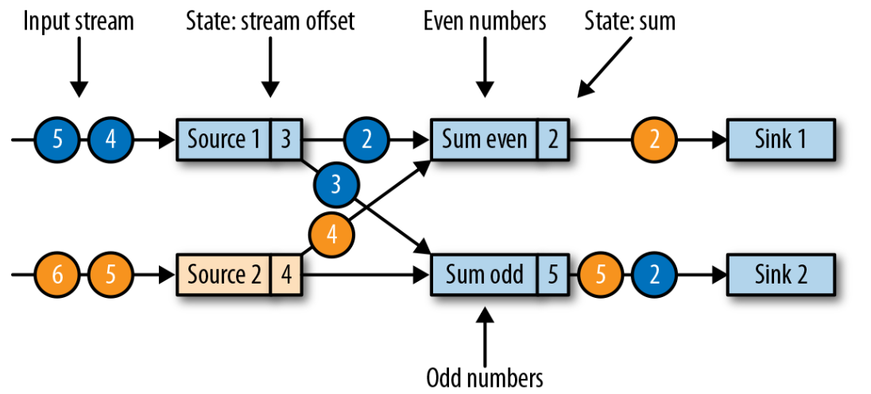
Streaming application with two stateful sources, two stateful tasks, and two stateless sinks

Slide 47
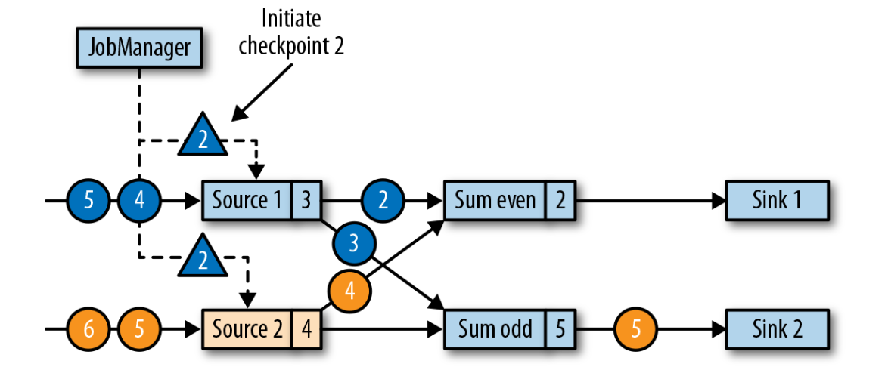
JobManager initiates a checkpoint by sending a message to all sources

Slide 48
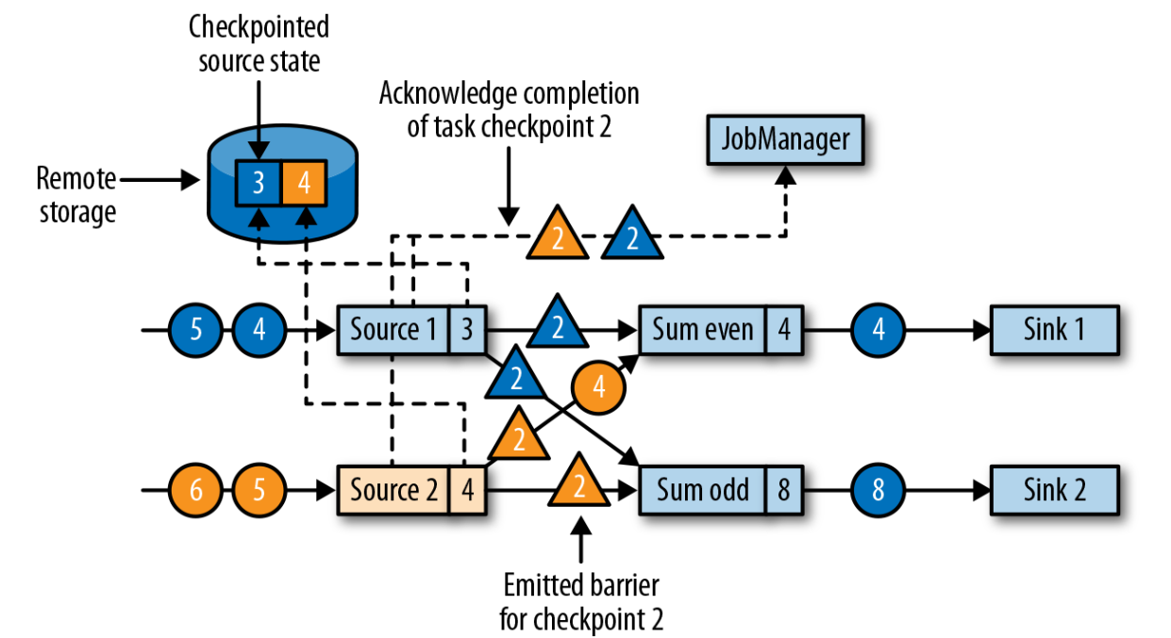
Sources checkpoint their state and emit a checkpoint barrier

Slide 49
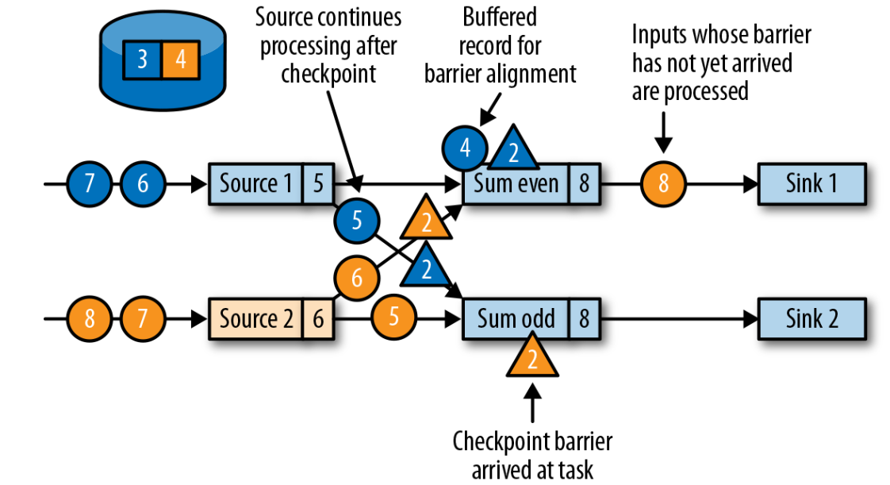
Tasks wait to receive a barrier on each input partition
Records from input streams for which a barrier already arrived are buffered
All other records are regularly processed

Slide 50
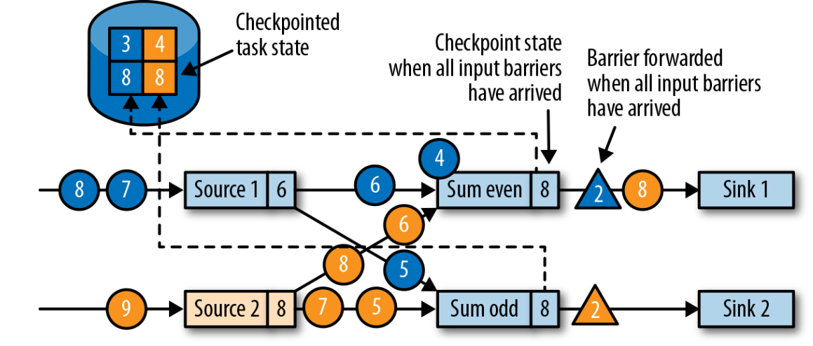
Tasks checkpoint their state once all barriers have been received, then they forward the checkpoint barrier

Slide 51
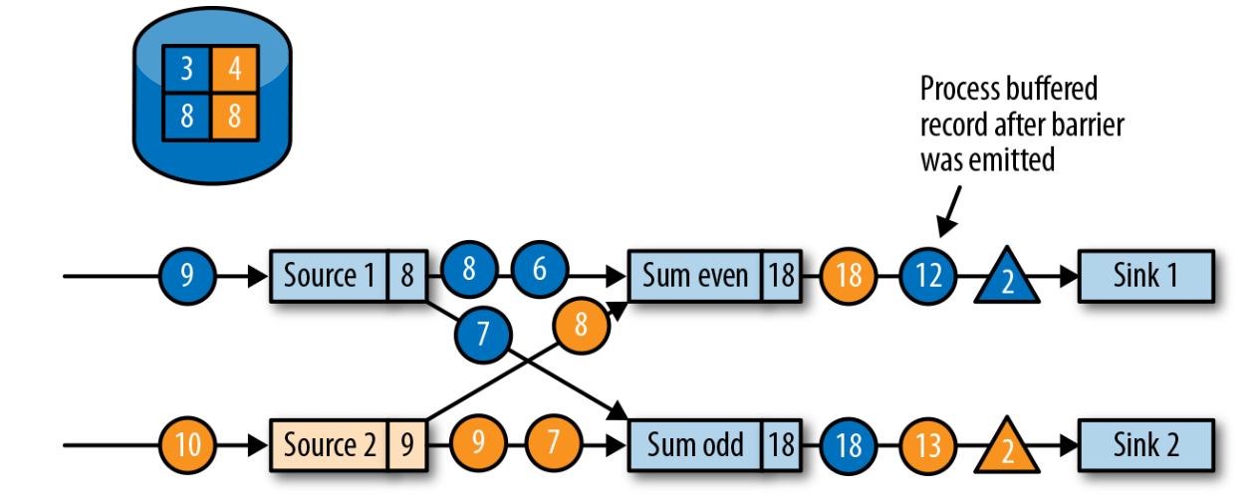
Tasks continue regular processing after the checkpoint barrier is forwarded

Slide 52
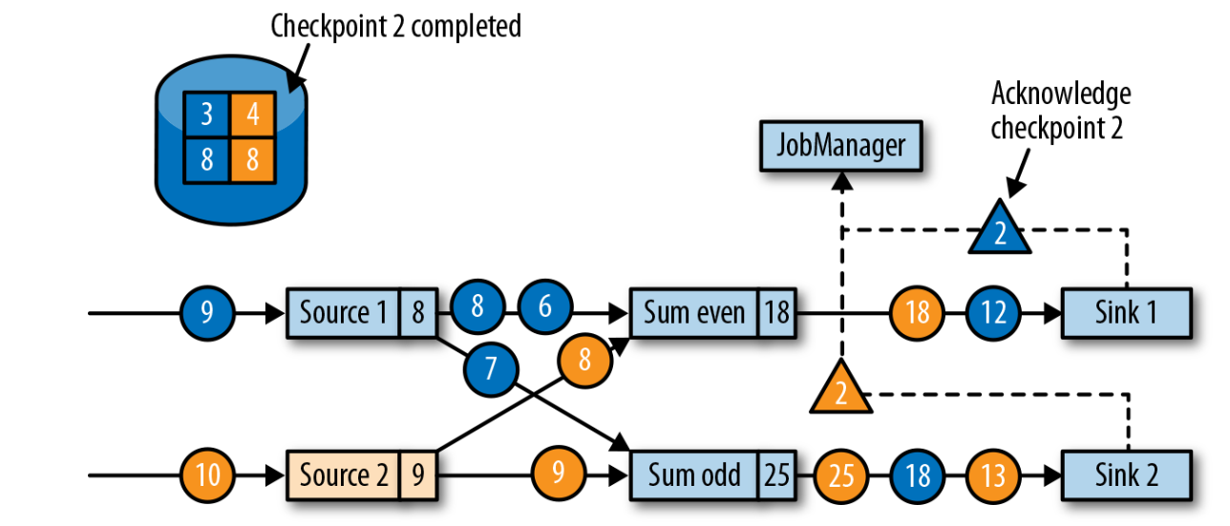
Sinks acknowledge the reception of a checkpoint barrier to the JobManager
a checkpoint is complete when all tasks have acknowledged the successful checkpointing of their state

Slide 53
Conclusion: a comparison between Spark vs. Flink
Spark
Microbatch streaming processing (latency of a few seconds)
Checkpoints are done for each microbatch in a synchronous manner (“stop the world”)
Watermark: a configuration to determine when to drop the late events
Flink
Real-time streaming processing (latency of milliseconds)
Checkpoints are done distributedly in an asynchronous manner (more efficient ➔ lower latency)
Watermark: a special record to determine when to trigger the even-time related results
Flink uses late handling functions (related to watermark) to determine when to drop the late events

Slide 54
Acknowledgements
CS4225 slides by He Bingsheng and Bryan Hooi
Jules S. Damji, Brooke Wenig, Tathagata Das & Denny Lee, “Learning Spark: Lightning-Fast Data Analytics”
Bill Chambers, Matei Zaharia, “Spark: The Definitive Guide”
Fabian Hueske and Vasiliki Kalavri, “Stream Processing with Apache Flink”, 2019
Tyler Akidau, Slava Chernyak and Reuven Lax, “Streaming Systems”, 2018

